Slide 1
Acquanym
By
Notes:
Frances

Slide 2
1.Team
2.Project
3. Documentation
4. Approach and Reflection
5. Roadmap
Agenda
Notes:
Frances

Slide 3
01
Team

Slide 4
Member | Role | Activities
Henry O’Brien 👽 | Leader/Scientist | Database/server setup, location services
Frances Wong ☠ | Chief Architect | UI Development
Adrian Van Katwyk 🚀 | Production Engineer | UI Development, documentation
Archit Sharma 🍫 | Requirements Engineer | FB integration, documentation
Kangming Zhang 🐯 | Quality Assurance | WeChat integration, documentation
Catherine Lee 🐼 | Marketing Manager | UI Design
Notes:
Frances

Slide 5
02
Project

Slide 6
Project
Acquanym
An app to help you remember the name and details of acquaintances and people you just met.
A contact list for the people you don’t know well enough to add on Facebook or Wechat.
Perfect for socialising, professional networking and even dating.
Notes:
Frances

Slide 7
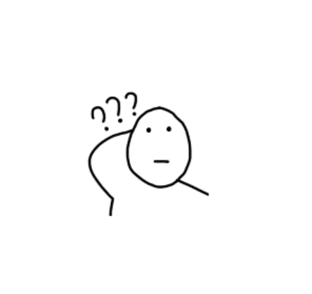
Client
Who can we help
All the people have problem with
remember the name or events of acquaintances
Teacher
Elder people
Student
Staff
… …
Employee
em… what’s your name…
Notes:
Frances

Slide 8
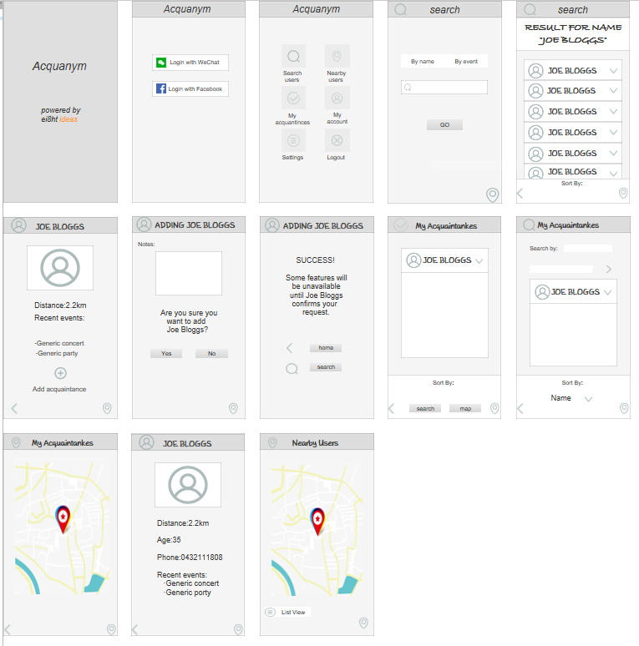
Project
Acquanym
like this
Notes:
Frances (Catherine?)

Slide 9
Project
Acquanym
App demo
Notes:
Henry

Slide 10
Project
Acquanym
Backend
Notes:
Henry

Slide 11
Project
Acquanym
FB/WeChat integration
Logs in FB and able to retrieve user info
Process
Register as developer and the app. Graph API for extracting info
Problems
Integrate FB SDK with android library. Compromise on version 26 vs 27.
Generating Key hash for FB (play store). PATH location & signing report didn't generate valid key.
Notes:
Archit & Coming

Slide 12
03
Documentation

Slide 13
Project
Documentation
https://github.com/SummerProgram2018/acquanym/wiki
Notes:
AdroDude

Slide 14
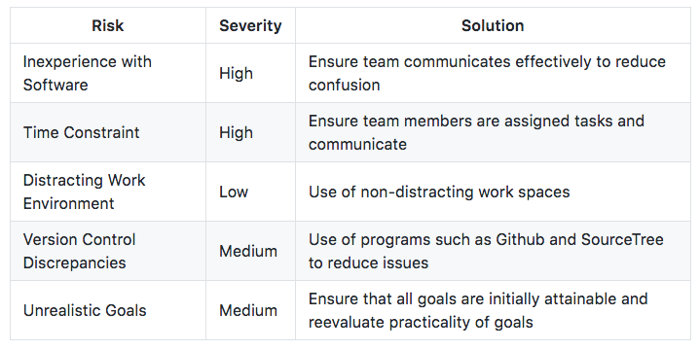
Project
Risk Management
Notes:
AdroDude

Slide 15
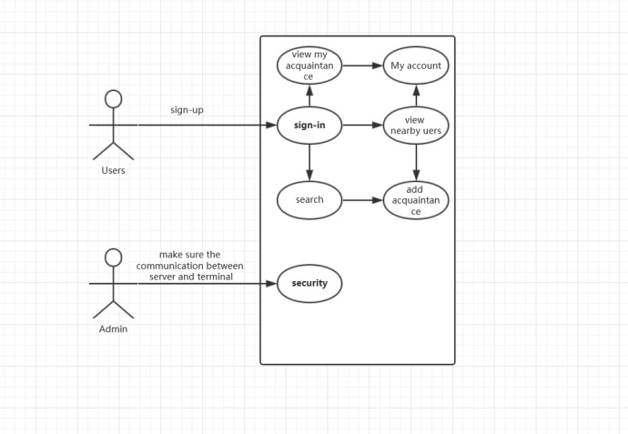
Project
UML Diagram
Notes:
Coming

Slide 16
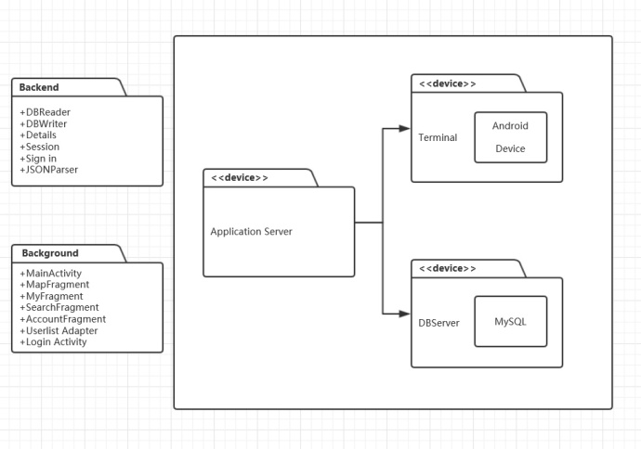
Project
Deployment Diagram
Notes:
Coming

Slide 17
Approach and Reflection
04

Slide 18
Approach and Reflection
Task Management
Trello
Regular Meetings
Version Control
GitHub
Sourcetree
App Development
Android Studio
MySQL
Flask
Axure
Notes:
Frances

Slide 19
Approach and Reflection
Reflection
Android Studio is not the best for a one-week project, especially when no one has any experience with it.
It is better to regularly check up on your team members to see if they need any help, rather than waiting for them to ask for it.
Adrian has learnt the value of collaboration and team work.
Archit had a hard time with Facebook.
Henry has learnt (refreshed himself) a lot about databases.
Notes:
Frances

Slide 20
05
Roadmap

Slide 21
Roadmap
Upcoming Features
WeChat/FB integration → upgrade to friend/contact, FB events
Better information security (harder to crack cryptographic algorithms)
More powerful database & server
Finding users based on physical descriptors → bitmoji, facial recognition
Suggestions to add users and reminders of acquaintance details using location and common events
Filter acquaintances on date/time of meeting
Smart background filtering of users given acquaintance connections
More attractive UI
Augmented reality using smart glasses (long-term goal)
Automated note taking from listening to conversations (long-term goal)
Notes:
Frances

Slide 22
Roadmap
Help people be the best one in memorization.
Make easier interpersonal communication.
Never forget ever good memory of life.
And become the best app in the world…
Notes:
Catherine

Slide 23
Thanks
By

